Slide 1
Finding an optimal housing location for a student in Amiens

Slide 2
Finding an optimal housing location for a student in Amiens
Housing is one of the most important things to consider when you make a decision to study abroad.
Studying in a European Youth Capital winner can be very appealing to students who are not sure about where they want to study.
Amiens is Europe’s Youth Capital of 2020.
There are a lot of things a student should consider when searching for an optimal housing location. Factor that should be considered are:
Number of venues around each location
Distance to the University and City Center
It is obvious that students would be very interested in an automated search engine that helps them decide where to stay in a city they want to study in.

Slide 3
Data acquisition and cleaning
Our main data requirements are the addresses of every neighborhood in Amiens and the coordinates of our two reference points (University Campus and City Centre).
We are also going to need the venues that exist in each neighborhood.
2 APIS are used in order to get the data we need.
Google Geocoding API
Foursquare Places API
2261 Candidate neighborhoods were generated.
Dropped any row that didn’t fulfill each student’s needs.

Slide 4
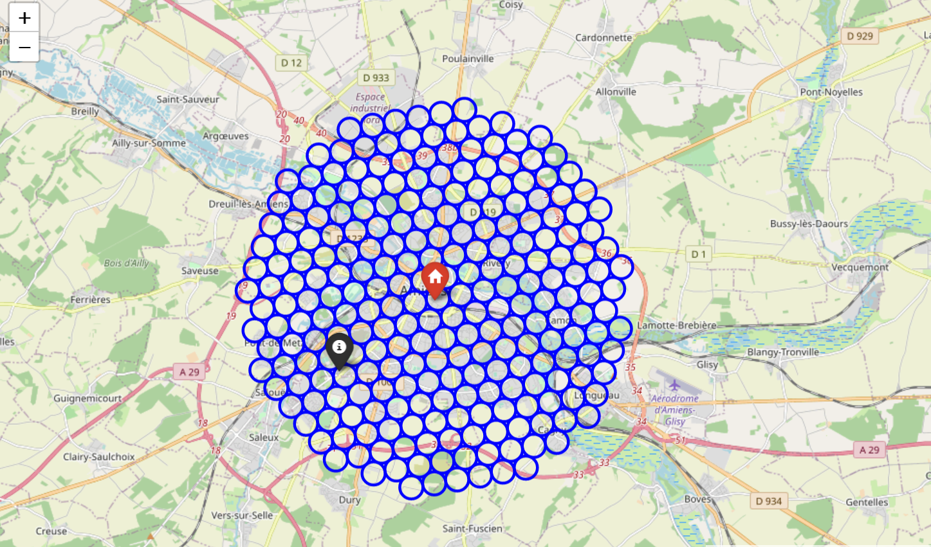
Candidate neighborhoods around City Center

Slide 5
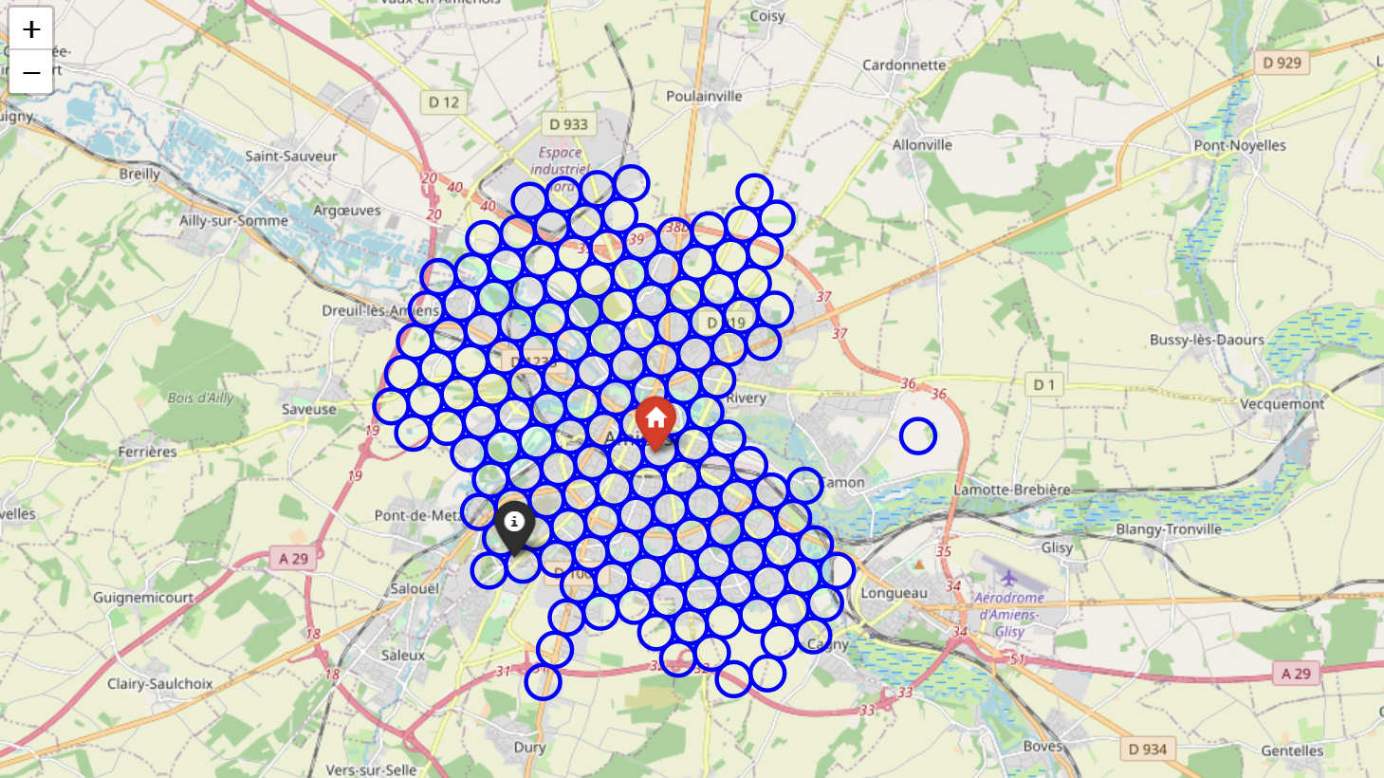
Candidate neighborhoods left after removing Addresses without the word Amiens.

Slide 6
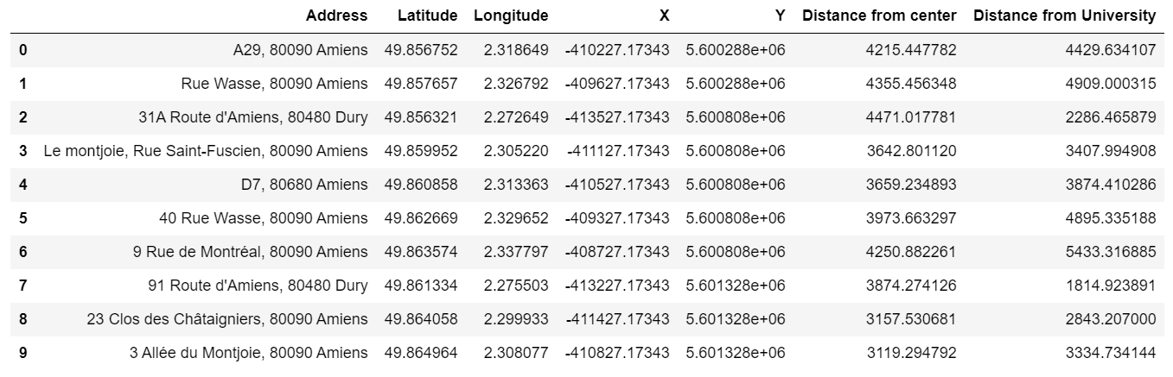
Dataframe of candidate neighborhood addresses and distances

Slide 7
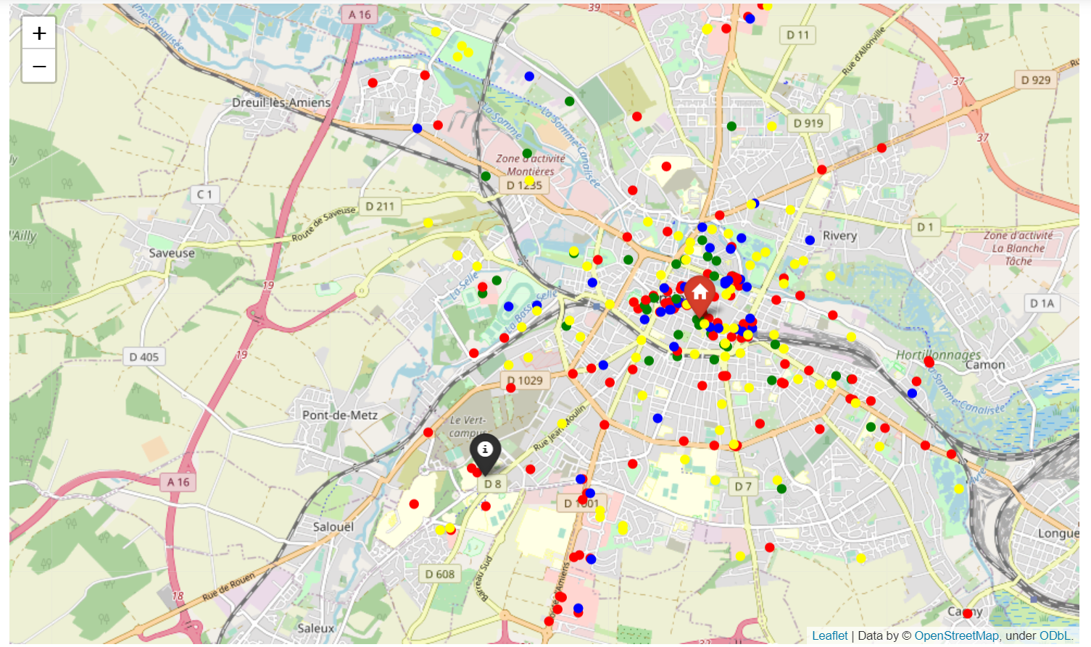
Different categories of venues around the neighborhoods of Amiens.
Four main categories of venues were used:
Arts & Entertainment
Food
Nightlife Spot
Outdoors & Recreation

Slide 8
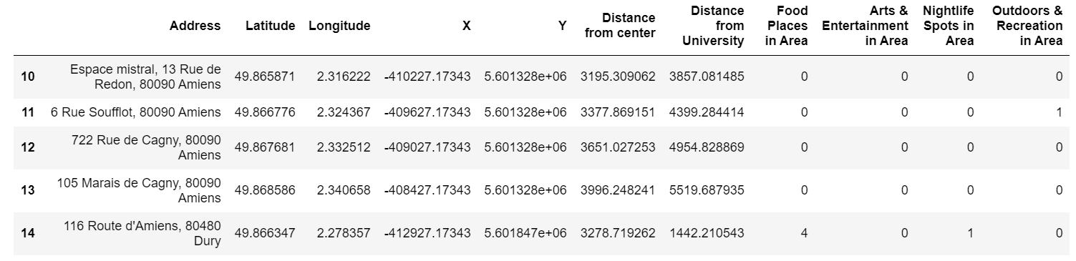
Dataframe along with number of venues for each category.

Slide 9
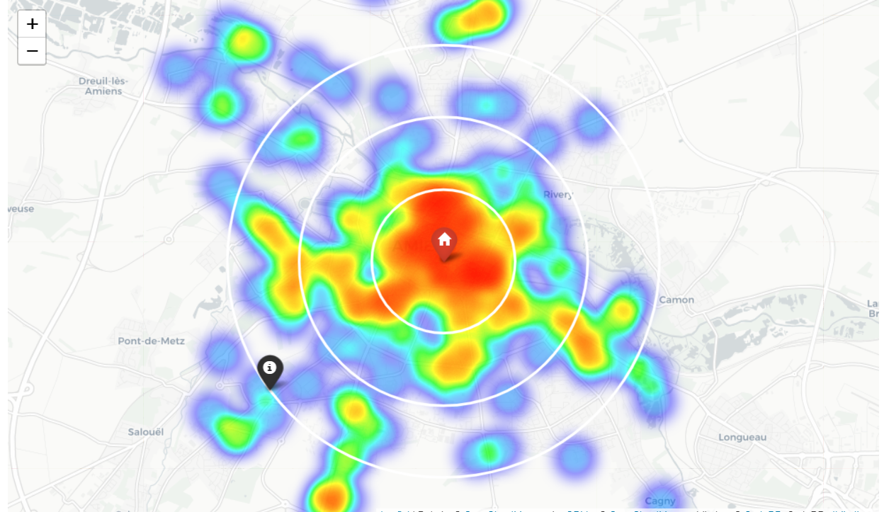
Heatmap based on the amount of venues around each location.

Slide 10
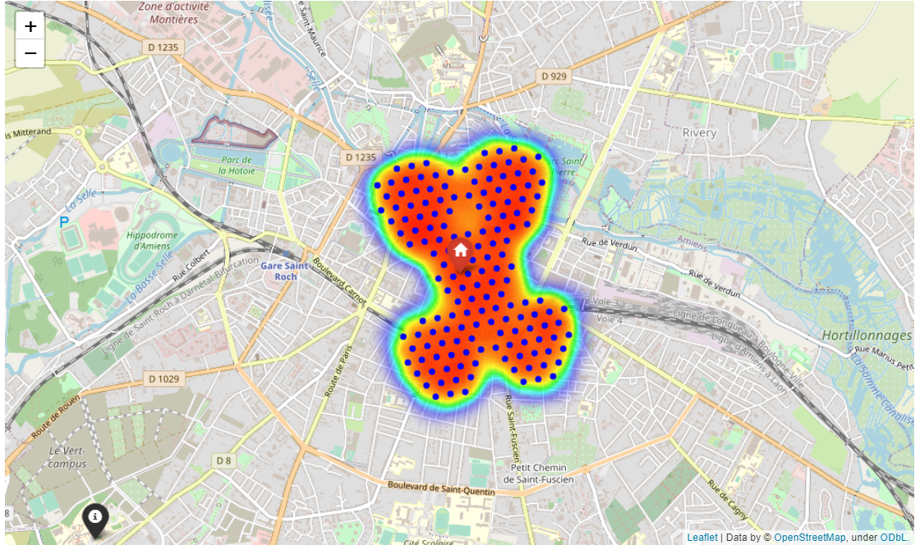
Areas with more than one of each venue nearby portrait with a heatmap.

Slide 11
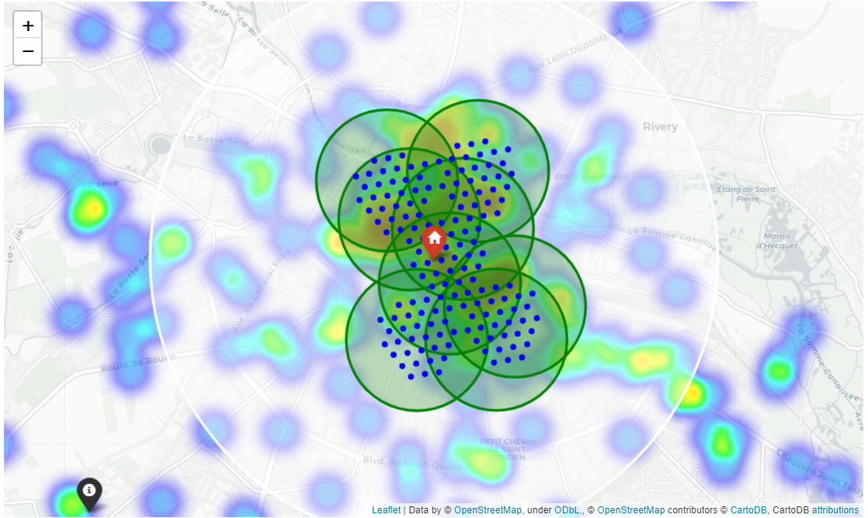
Clusters around each neighborhoods portrait with a heatmap.

Slide 12
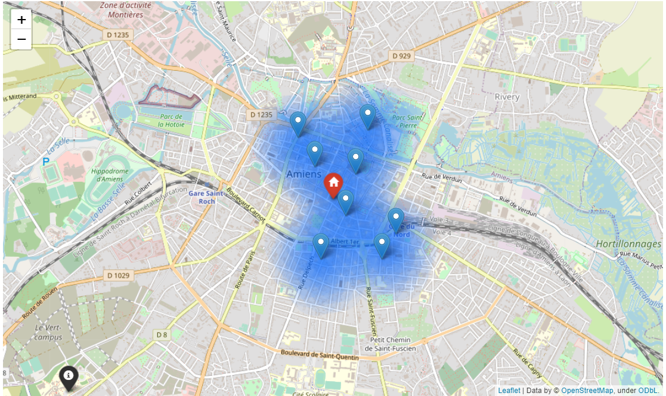
Optimal housing locations from Model 1

Slide 13
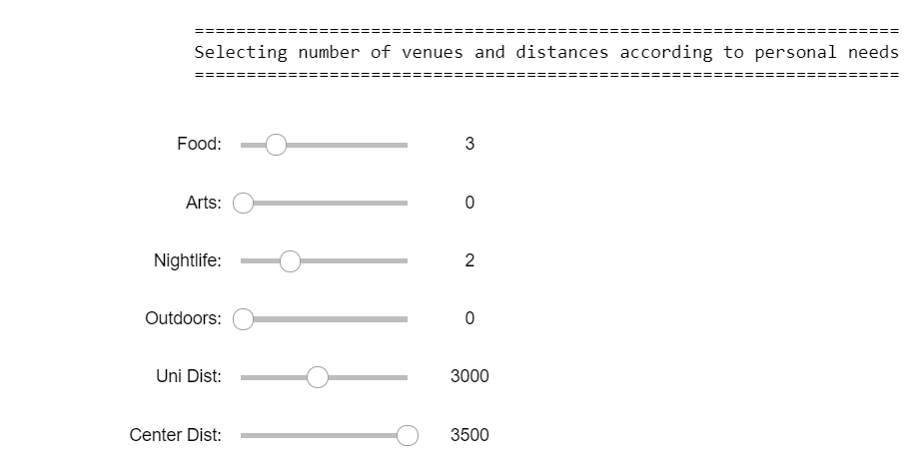
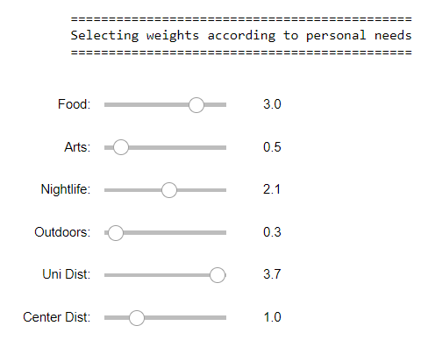
We wanted to personalize the locations to each student’s needs so we added:
Weights for the importance of each category
The option to choose any number of each category of venues nearby
The option to choose max distance from any of our 2 reference points

Slide 14
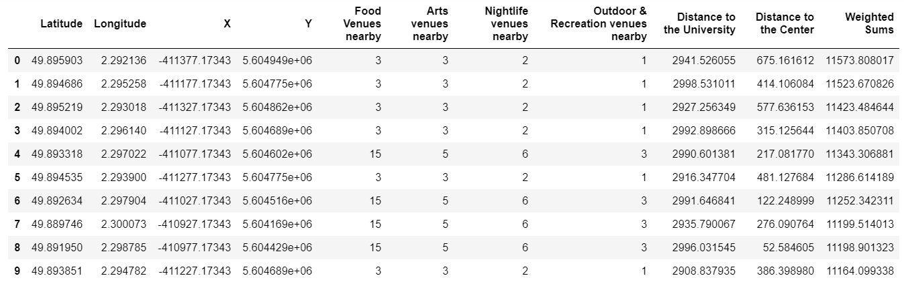
Dataframe sorted by weighted sums

Slide 15
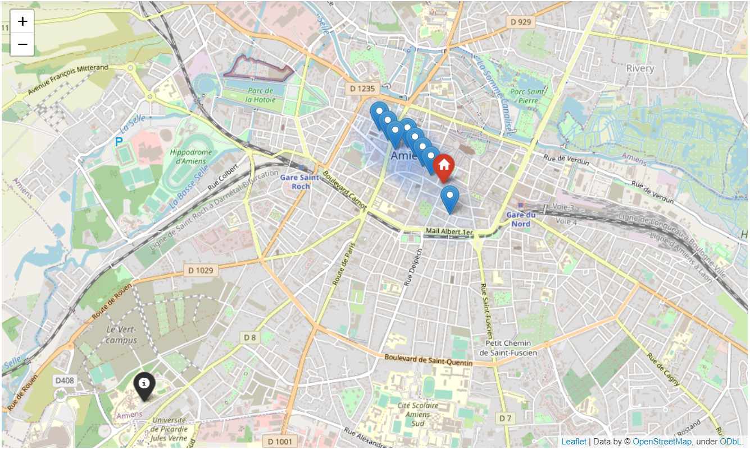
Final optimal housing locations generated by the second model.

Slide 16
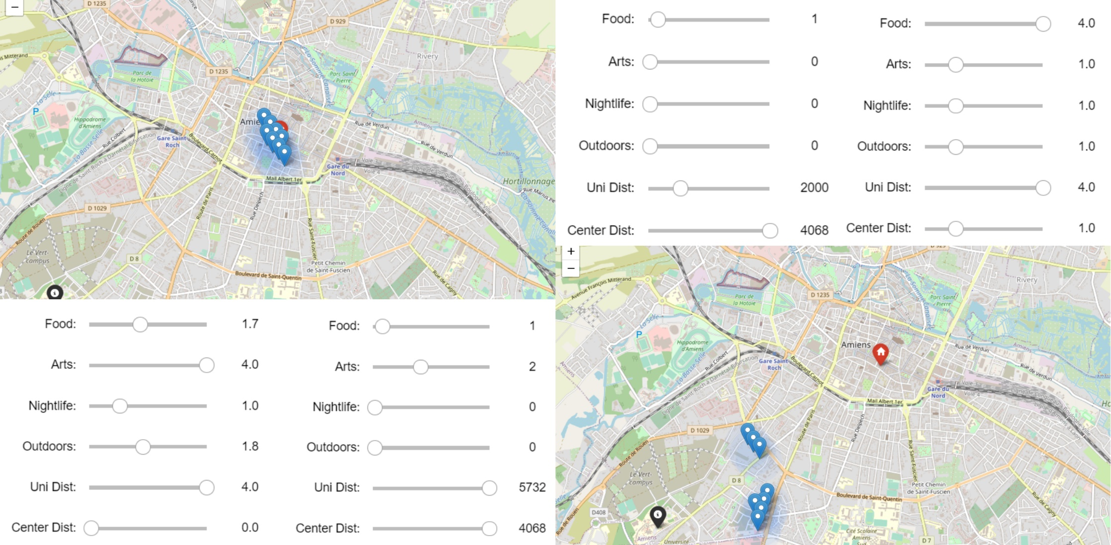
(Left Map Bottom Sliders): Results of second model while interested mainly in Art and Outdoor venues and not interested in distances. (Right Map Top Sliders): Optimal Areas under 2km from the university interested mainly in food venues.

Slide 17
Conclusion and future directions
We were able to achieve interesting results with both clustering and normalized weight values.
However, there is a huge variance in things that may fulfil a student’s needs.
For example, one of the biggest factor in our opinion that was not taken into account is the student’s budget.
We can deepen the models even more by taking into consideration each student’s hobbies or activities.
We can also use metadata using Google Forms so as to adapt very specific needs in our models.

